Slide 1
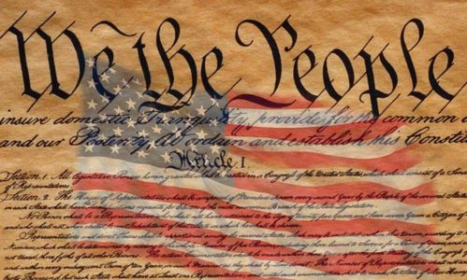
First Amendment Audits
Illinois Property Assessment Institute
68th Annual State Conference
Marriott Hotel & Conference Center
Normal IL
March 23, 2026

Slide 2
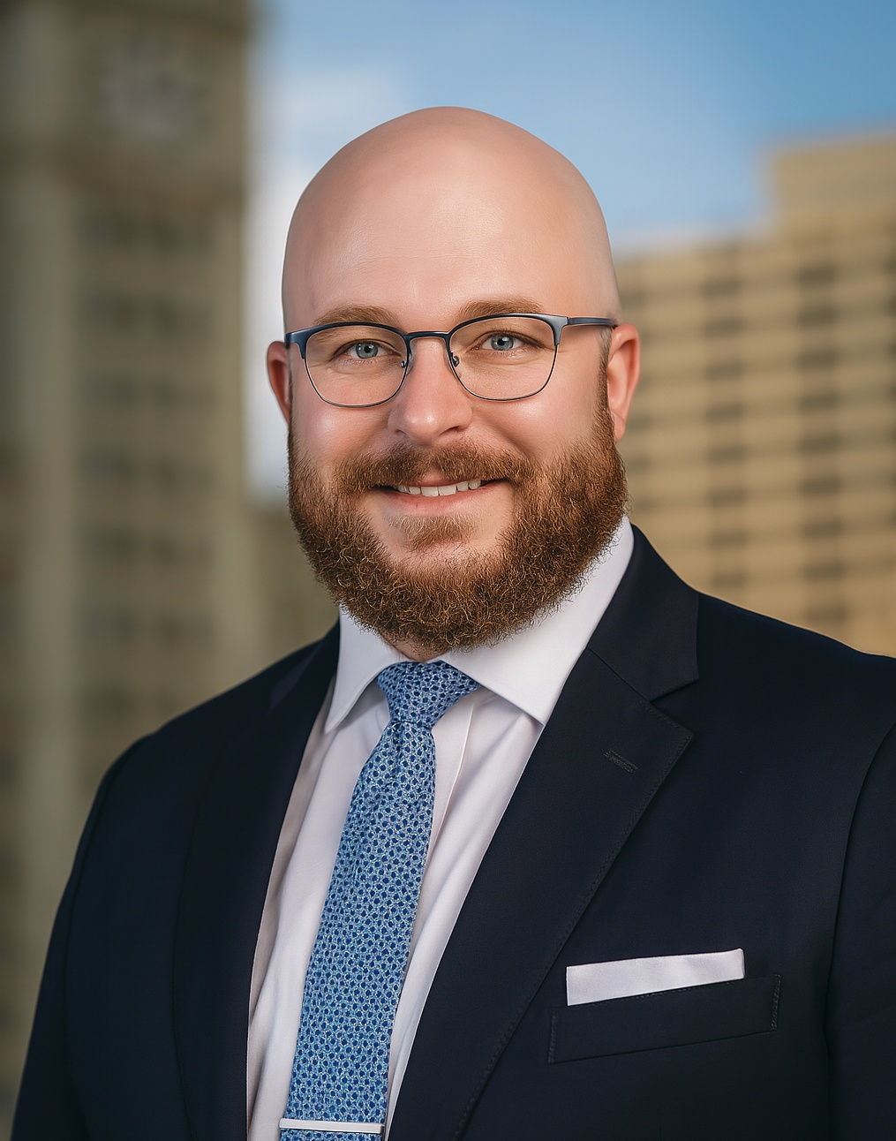

Airdo Werwas, LLC
Mark J. Kimzey
111 E. Wacker Drive
Suite 500
Chicago, Illinois 60601
P: 312.506.4480
F: 312.506.4460
mkimzey@airdowerwas.com

Slide 3
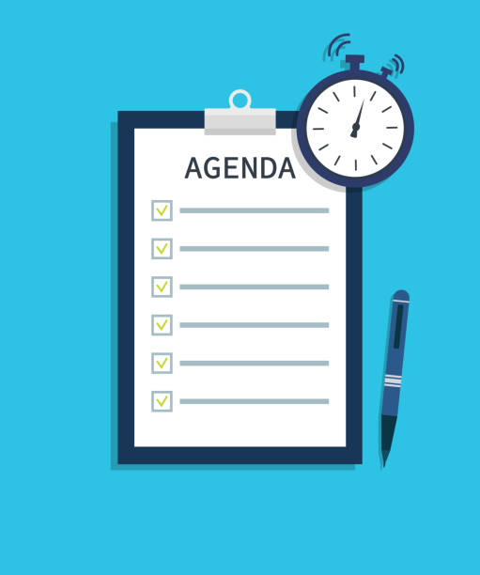
Agenda
    Background
    Legal Landscape
    Practical Considerations

Slide 4
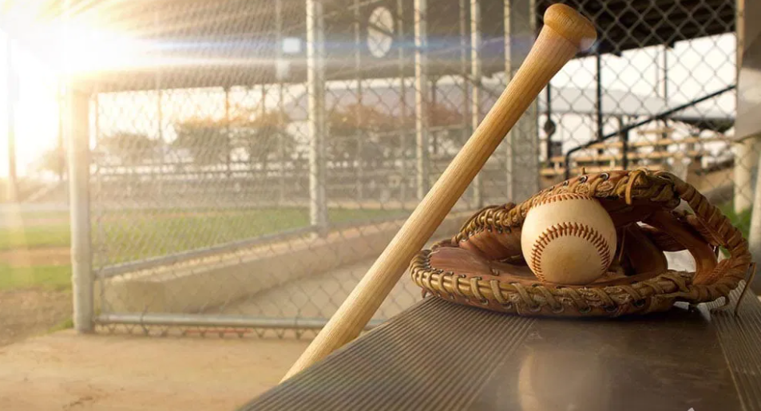

Slide 5


Slide 6
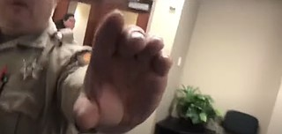
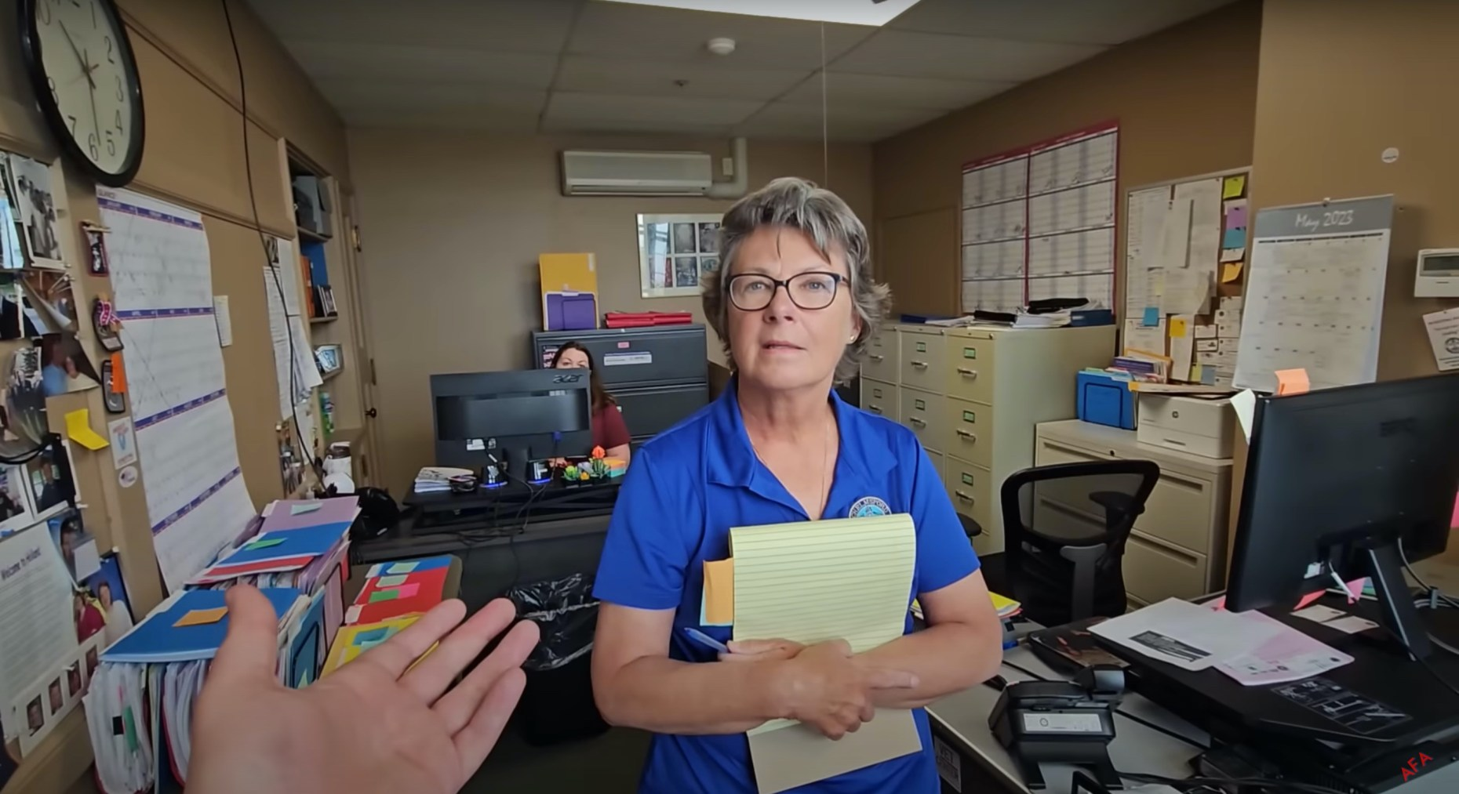
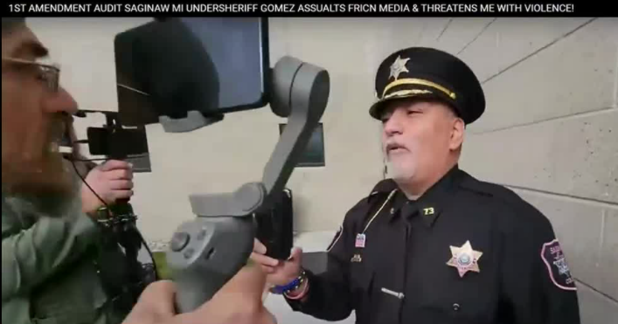
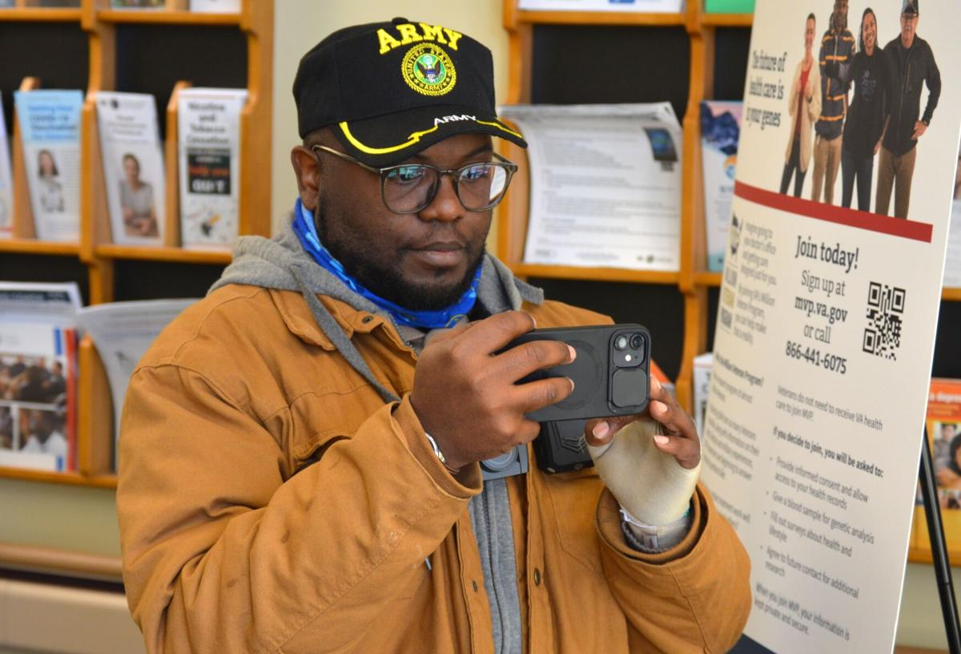
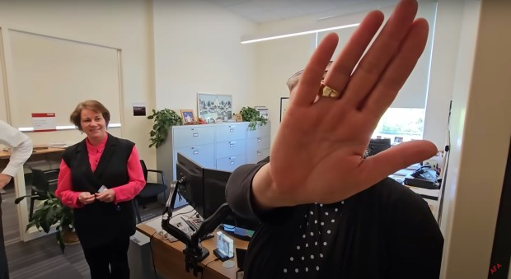

Slide 7
What is a First Amendment Audit?
  Relatively new social movement and form of activism
  Individuals or groups enter and film on government property
        To challenge your knowledge and acceptance of their free speech rights
        By testing those limits and gauging your reactions.

Slide 8
Growth & Evolution
  Started with police, expanded to other public employees.
  Courts affirm citizens’ right to film public officials.
  Smartphones and social media fueled rapid growth of audits.
Notes:
Initially, many audits focused on filming police activity; over time, auditors expanded to other public employees in municipal offices, libraries, and other governmental settings.
The legal doctrine that citizens may film public officials is supported by multiple court decisions recognizing that gathering information about government is part of press/speech freedoms.
In the smartphone and social media era, the phenomenon has accelerated as widespread access to video recording tools gave more citizens the ability to document official conduct.

Slide 9
The “Audit” Process
  Auditors commonly show up unannounced and:
  Film or photograph government sites and areas.
  Seek access to governmental records
  Record officials, employees, and others in public spaces.
Notes:
Photograph or film government buildings, offices, control points, and common or sensitive areas, including parking lots and vehicles.
Seek access to governmental records, request complaint or grievance forms, or ask for copies of select administrative policies.
Record public officials, governmental employees and citizens that are present and may demand the identity of personnel within their view.

Slide 10
What to Expect?
  Auditors take on different styles:
      Some are quiet and unassuming.
      Others may be openly vocal and even try to bait employees into an argument by being disrespectful, rude, and condescending.
  Many expect to be confronted.
  Some are prepared to be detained and arrested.

Slide 11
Motivations
  Honest desires to hold government accountable.
  Political and personal resentment.
  “The search for relevance.”

Slide 12
How to Make Money on…

Slide 13
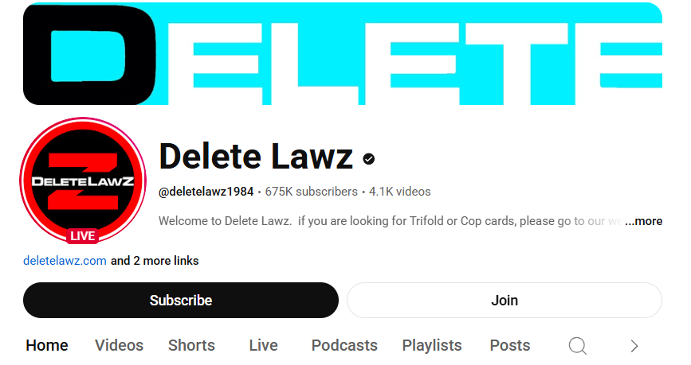
Channels

Slide 14
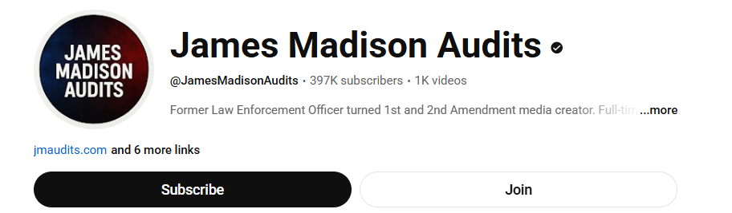
Channels

Slide 15
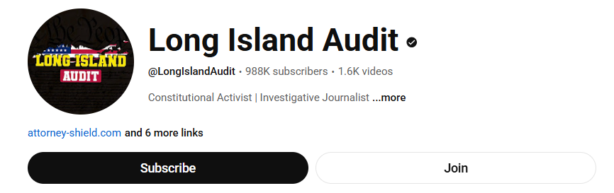
Channels

Slide 16
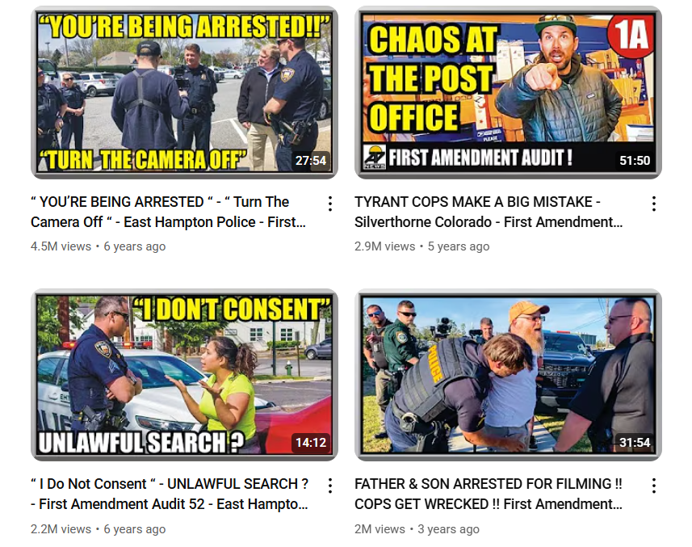
Videos

Slide 17
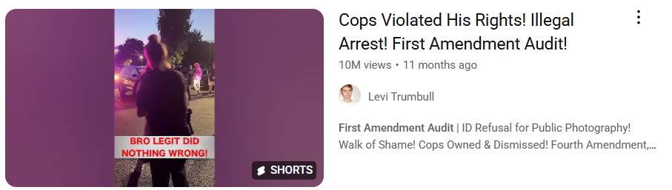
Videos

Slide 18
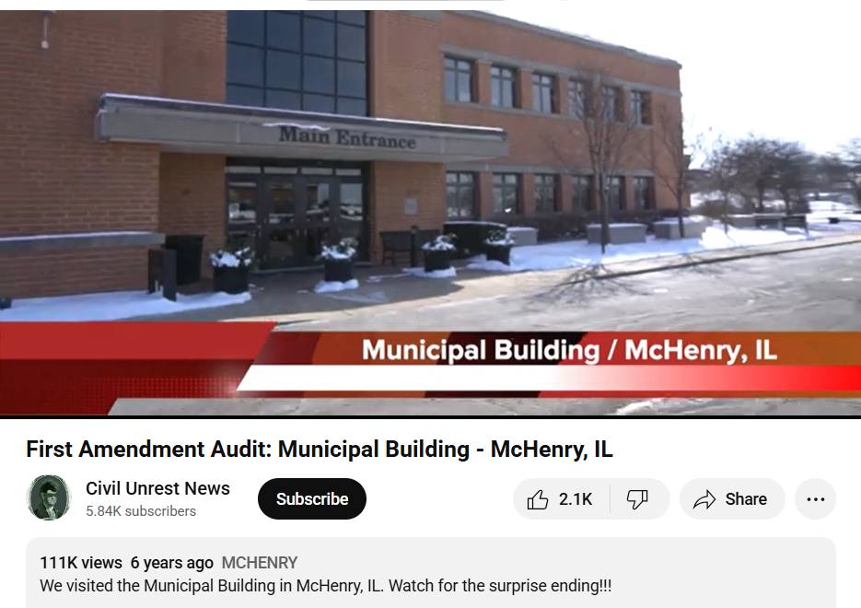
Video here in Illinois

Slide 19
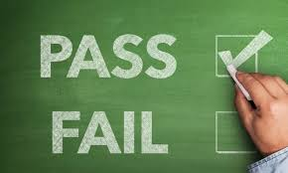
Making the Grade
  An uneventful audit is akin to “passing a test.”
  A confrontational audit gets a failing grade.

Slide 20
Consequences of a “Fail”
  Poorly handled audits may also result in:
  Litigation
  Bad press
  Return visits
  Other audits

Slide 21
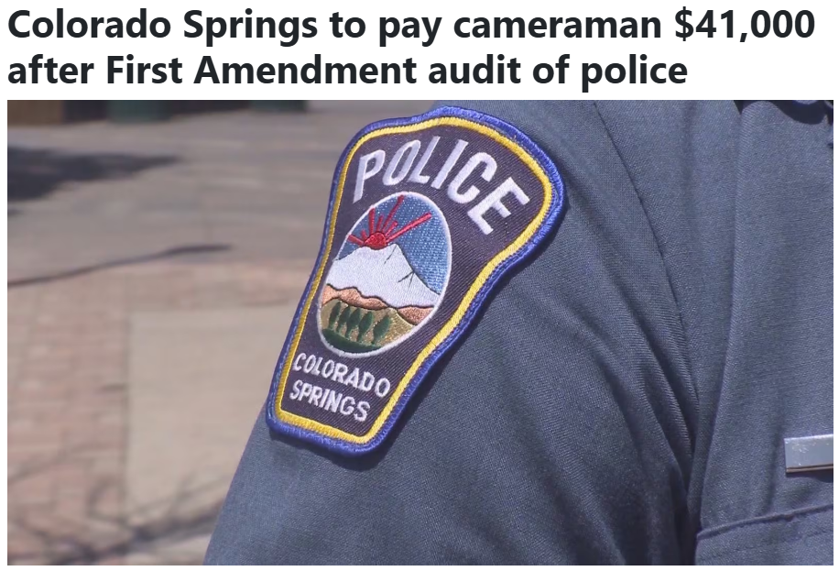
Consequences of a “Fail”

Slide 22
Consequences of a “Fail”
  Auditor detained while filming Colorado Spring Police.
  Sparked First Amendment Dispute.
  City settled for $41,000.00 without admitting wrongdoing.
Notes:
A YouTube “First Amendment Auditor” filmed outside the Colorado Springs Police Department to test public officials’ response to recording in public spaces.
Police officer detained the cameraman, claiming his filming was suspicious.
The encounter led to public criticism and a legal claim alleging violation of First Amendment rights.
The City of Colorado Springs agreed to pay $41,000 to settle the case.
The settlement did not admit wrongdoing, but aimed to avoid future litigation.

Slide 23
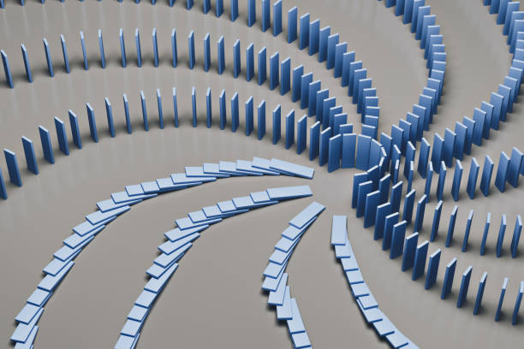
The “Domino Effect”

Slide 24
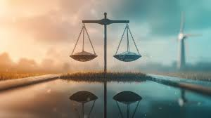
Legal Landscape

Slide 25
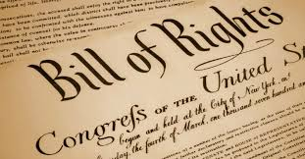
The First Amendment
  “Congress shall make no law…abridging the freedom of speech, or of the press; or the right of the people peaceably to assemble, and to petition the government for a redress of grievances.”

Slide 26
The First Amendment
  The right to record is protected by the First Amendment.
  Free Speech
  Free Press
  Assembly
  Petition for Redress

Slide 27
The Right to Record
  The general rule:
  Public Officials
  Public Places
  Public Business

Slide 28
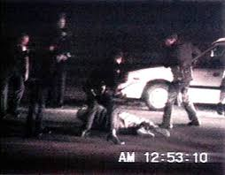
Early Roots & Precedents
  One of the earliest and most famous incidents often cited is the 1991 videotaped beating of Rodney King by Los Angeles Police.
  It was recorded by a bystander, and later broadcast widely.

Slide 29
Glik v. Cunniffe (1st Cir. 2007)
  Simon Glik saw three Boston police officers arresting a young man on the Boston Common.
  Believing the officers were using excessive force, Glik stood about ten feet away and openly recorded the arrest with his cell phone.
  After placing the man under arrest, an officer turned to Glik and told him he had "taken enough pictures.”
  The court held that a private citizen has the right to record public officials performing their duties in a public place, subject to reasonable limits.

Slide 30
Berge v. Gloucester S.D. (1st Cir. 2007)
  A parent, Berge, went to the superintendent's office to discuss COVID-19 policies after he was unable to get tickets to his daughter's play.
  While there, he openly recorded his interaction with school officials and later posted the video to Facebook.
  The superintendent sent a letter demanding he remove the video or face legal action, citing the state's wiretap statute.
  The court held that threatening legal action to suppress speech on a matter of public concern is a "textbook First Amendment violation"

Slide 31
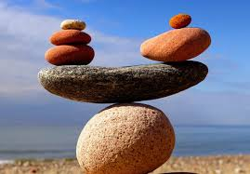
Rights are Not Absolute!
  They are balanced against competing interests:
      Safety & Efficacy
      Order & Control
      Privacy & Confidentiality

Slide 32
Government Property Ownership
  Government ownership of property does not automatically open that property to all public uses.
  Governments have the right to designate their property for specific uses.
  Governments have the right to proscribe uses inconsistent with those designations.

Slide 33
The Importance of Location
  The right to access public property and the standard by which limitations upon free speech exist differ depending on the character of the property.
  Courts have defined three types of public property:
      Public Forums
      Designated Public Forums
      Nonpublic Forums

Slide 34
Traditional Public Forums
  Areas that have been traditionally used for expressive activity like assembly or debate.
      Generally, exterior areas are likely to be considered traditional public forums,
      E.g., streets, parks, sidewalks, plazas

Slide 35
Designated Public Forums
  Public property the government has opened for use by the public as a place for expressive activity.
      Intent open a forum to expressive activity by members of the public is key.
      Based on policies, practices, and history regarding purpose, use, and access

Slide 36
Non-Public Forums
  Public property which is not by tradition or designation a forum for public expression (a.k.a. all other public property).
      Property used to conduct or facilitate government business
      E.g., government employee offices, lobby areas of government buildings, interior of polling places, prisons and jails, courthouses, terminals in publicly operated airports, and military bases
      Social services agencies and public health departments, too!

Slide 37
Restrictions on Speech
  Public Forums: time, place, and manner restrictions are permissible if:
      Content-neutral
      Narrowly tailored to serve a significant government interest
      Leave open ample alternative channels of communication
  Non-Public Forums: restrictions are permissible if:
      Viewpoint-neutral
      Reasonable in light of the purpose of the forum

Slide 38
Restrictions on Filming
  Public Forums: time, place, and manner restrictions are permissible if:
      Content-neutral
      Narrowly tailored to serve a significant government interest
      Leave open ample alternative channels of communication
  Non-Public Forums: restrictions are permissible if:
      Viewpoint-neutral
      Reasonable in light of the purpose of the forum

Slide 39

Protected Privacy Interests
Public Aid Code
Mental Health & Developmental Disabilities Act
HIPAA
“Public Exposure”
Captive Audiences

Slide 40
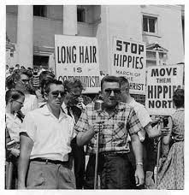
Practical Considerations
  Develop & adopt reasonable content-neutral rules on recordings
      Think time, place, and/or manner

Slide 41
Practical Considerations
  Identify and mark nonpublic forums.
      Mark restricted areas such as garages, hallways, cubicles, offices and workspaces with signs that define access.
      Examples:
          “Authorized Personnel Only”
          “Employees Only”
          “No Admittance without Official Business”
          “By Appointment Only”

Slide 42
Practical Considerations
  Educate & Train Employees:
      All public-facing employees should have familiarity with First Amendment audits and how to respond to them.
      Emphasize consistent and neutral application of rules.
      De-escalation is crucial.

Slide 43
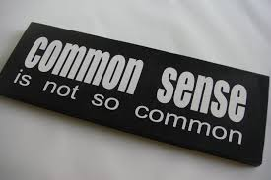
Practical Considerations
  Discuss how these audits are to be handled before one takes place
  Use common sense
  Consider whether there is any actual harm from the recording/audit

Slide 44
Practical Considerations
  When contacting an auditor, DO NOT:
      Overreact.
      Attempt to take their recording device.
      Arrest or detain them based only on the fact they are recording.
      Follow or intimidate them.

Slide 45
Practical Considerations
  When contacting an auditor, DO:
      Stay calm.
      Be polite and patient.
      Act in conformity to the Department’s Mission, Vision and Values
      Comply with Policies and security requirements
      Let them film as long as they are not committing any crimes or disrupting the use of the property.

Slide 46
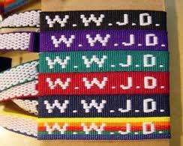
Final Advice

Slide 47
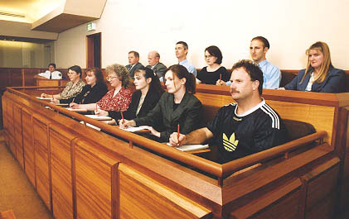
What Would a Jury Do?

Slide 48
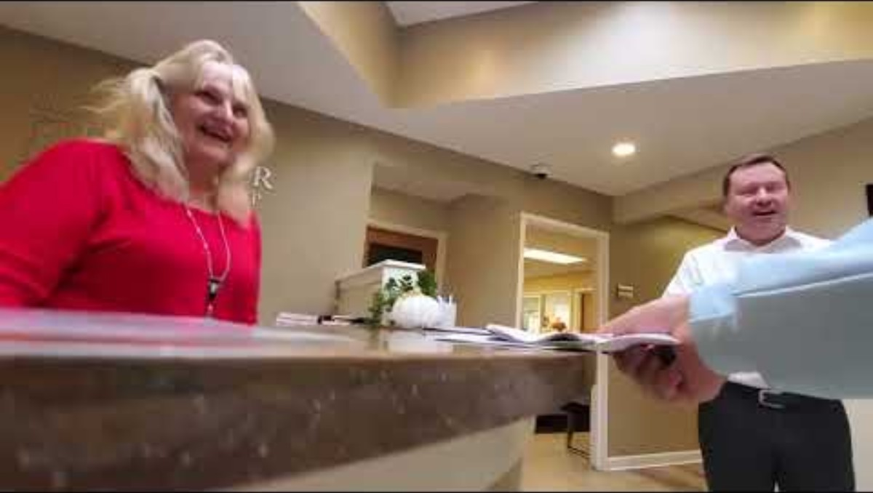
Personal Interaction

Slide 49
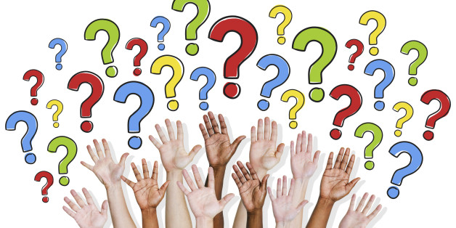
Questions?

Slide 50
Thank You!
Mark J. Kimzey
111 E. Wacker Drive
Suite 500
Chicago, Illinois 60601
P: 312.506.4480
F: 312.506.4460
mkimzey@airdowerwas.com

