Slide 1
Records Retention and The Local Records Act
Presented by:
Josh Langfelder
Archival Program Administrator
Illinois State Archives
jlangfelder@ilsos.gov
Notes:
Submitted a disposal certificate?
Know you have an Application for Authority to Dispose of Local Records, but don’t know what to do with it?
Think I’m speaking a different language?

Slide 2
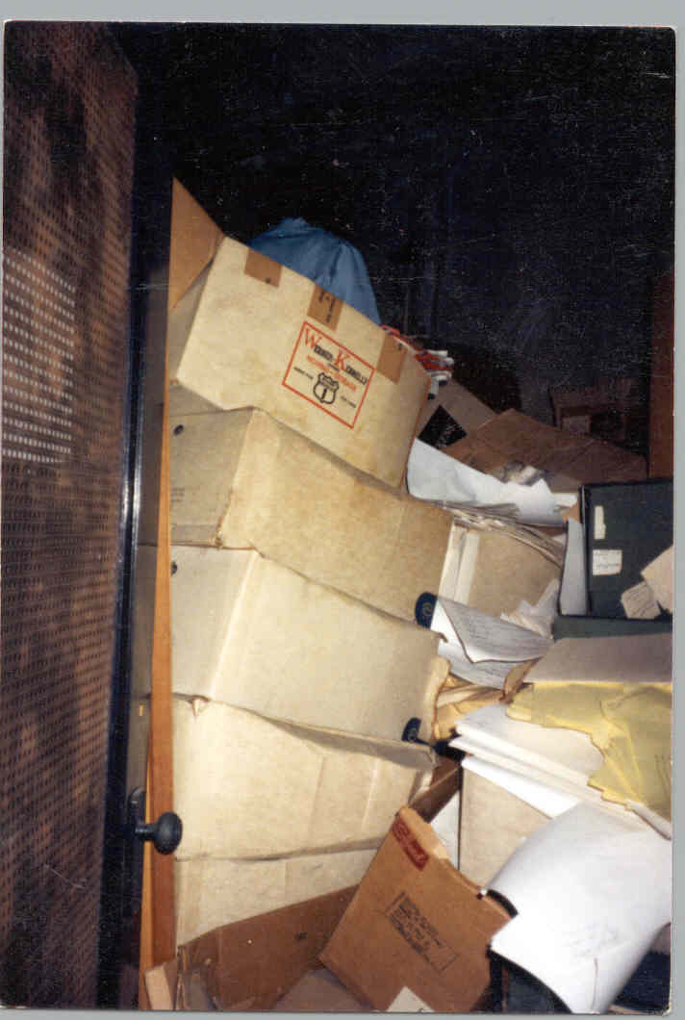
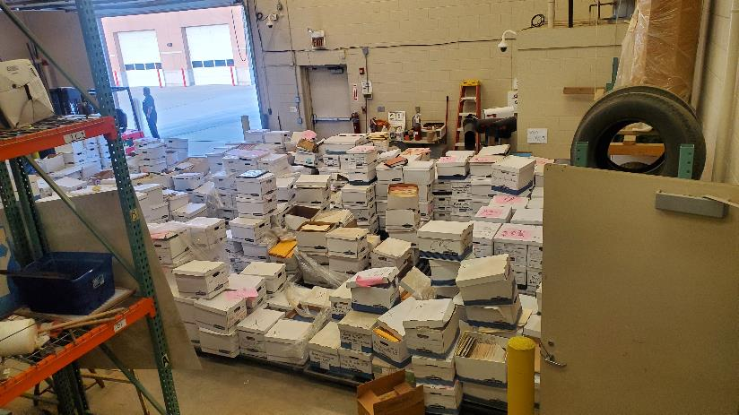
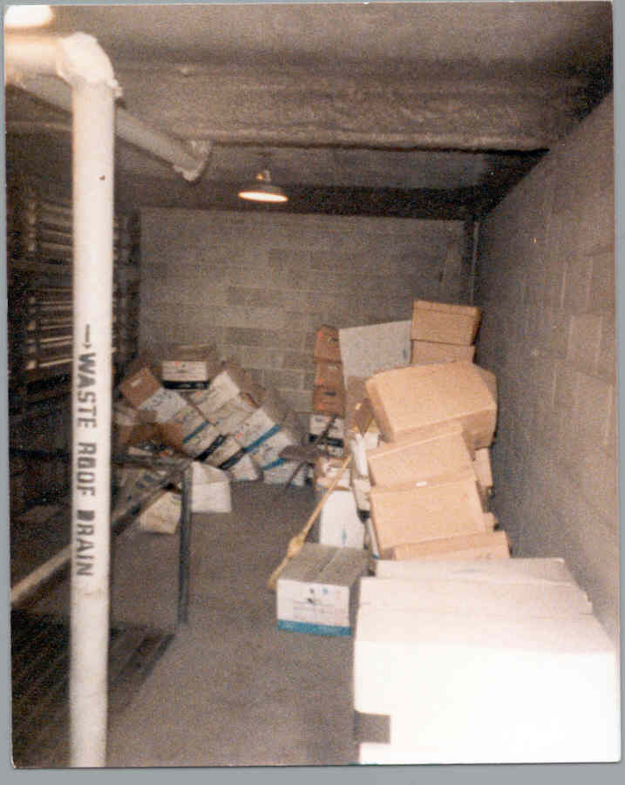
Welcome to the exciting world of records management.*
*enthusiasm is optional.
Notes:
This is a really boring topic
It can be intimidating

Slide 3
What is the Local Records Act?
The Local Records Act (50 ILCS 205) was passed in 1962 as a method for local government agencies to legally dispose of their records.
Establishes the Local Records Commission to determine retentions and provide approval for authority.
Places responsibility for compliance on local government agencies.
Mandates the Secretary of State to provide support.

Slide 4
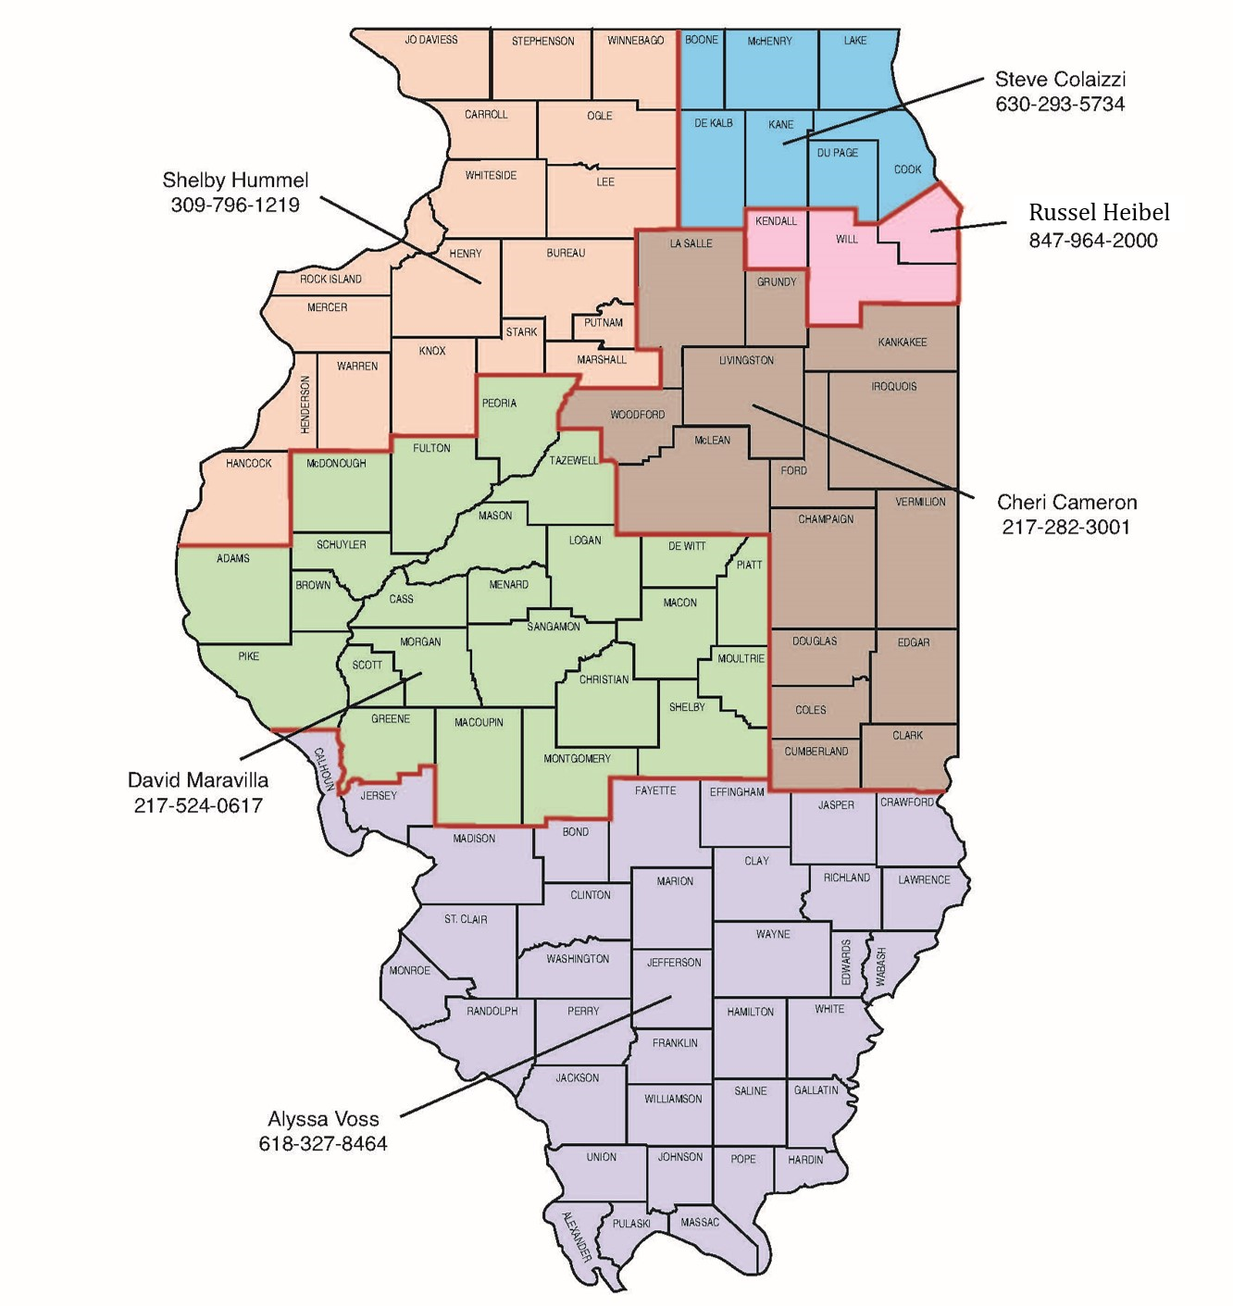
What does the Local Records Unit do?
Serve as liaisons between your agency and the Local Records Commission.
Assist with establishing or updating Applications for Authority to Dispose of Local Records
Provide support with Disposal Certificates.
We’re free, too.

Slide 5

Who do we help?
Municipalities
Police
Fire
Libraries
Utility / Public Works
Community Colleges
School Districts
County Agencies
Townships
Districted agencies (FPD, Libraries)
If your agency is publicly funded, then you must comply with the Local Records Act.
Notes:
Point out departmental obligations
Police 10 years
Libraries frequently stand alone

Slide 6

What is a Public Record?
any book, paper, map, photograph, born-digital electronic material, digitized electronic material, electronic material with a combination of digitized and born-digital material, or other official documentary material, regardless of physical form or characteristics, made, produced, executed, or received by any agency or officer pursuant to law or in connection with the transaction of public business and preserved or appropriate for preservation by such agency or officer, or any successor thereof, as evidence of the organization, function, policies, decisions, procedures, or other activities thereof, or because of the informational data contained therein.
(Source: P.A. 99-147, eff. 1-1-16.)

Slide 7
Let’s simplify:
Any [informational] material, regardless of form, produced or received pursuant to law or the transaction of public business and preserved as evidence of activity of the [local government agency].

Slide 8

What is NOT a public record?
Extra copies of documents preserved only for convenience or reference (copies of meeting minutes, duplicate board packets)
Stocks of publications and processing documents (superseded blank forms)
Junk emails or mail (party announcements, business cards, and unsolicited sales brochures, “cake in the breakroom” emails)
Working files, drafts (drafts of grants; staff desktops)

Slide 9
Are emails, text messages, videos, audio recordings, social media, and faxes public records?
Records are MEDIA NEUTRAL.
If the information fits the definition, it is a public record.
Examples: emailed invoices, agency head sends email to staff, recordings of public meetings, surveillance video, Facebook comments…
Many emails are Transitory Records and do not meet the definition of public record (cc’d emails, routine memos, system generated messages, etc.)
Email retention policies help manage retention.

Slide 10

How can I manage social Media?
Develop a policy for comments and pin it. We recommend no comments.
Keep an internal log of postings in a text file. This is your original document and posts are convenience copies.
Retention for log and commented posts is three years.
If posts don’t have comments, hide them after a specified time (48 hours).
DO NOT DELETE COMMENTS THAT ARE PROTECTED UNDER FREEDOM OF SPEECH.

Slide 11
What’s an Application for Authority to Dispose of Local Records?
It’s your unique retention schedule.
The application is a long-term document
May be added to and amended.
It gives you AUTHORITY to SEEK permission to dispose but does NOT give you PERMISSION to dispose.

Slide 12
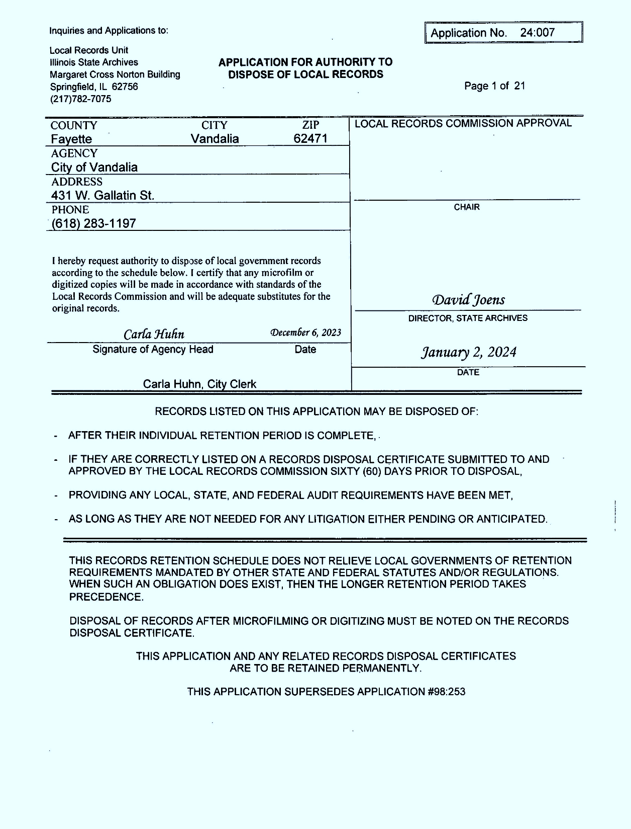
Notes:
inventory

Slide 13
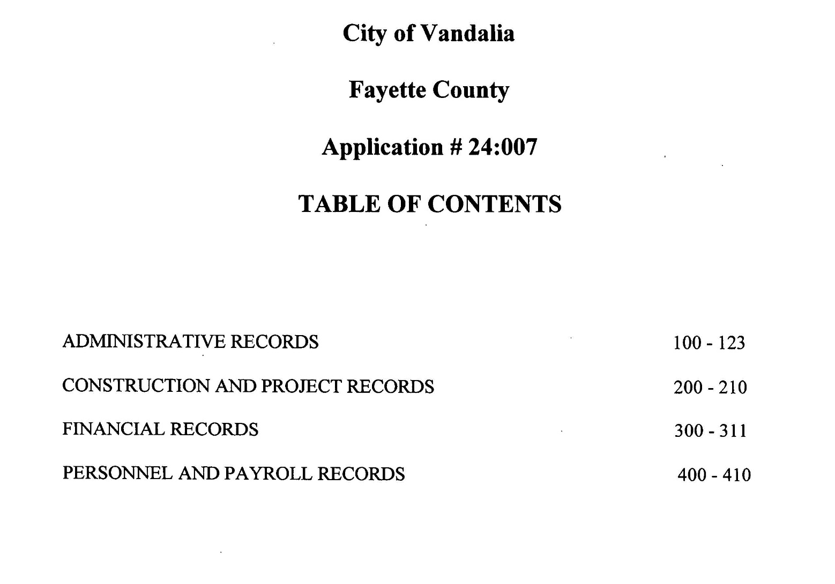

Slide 14
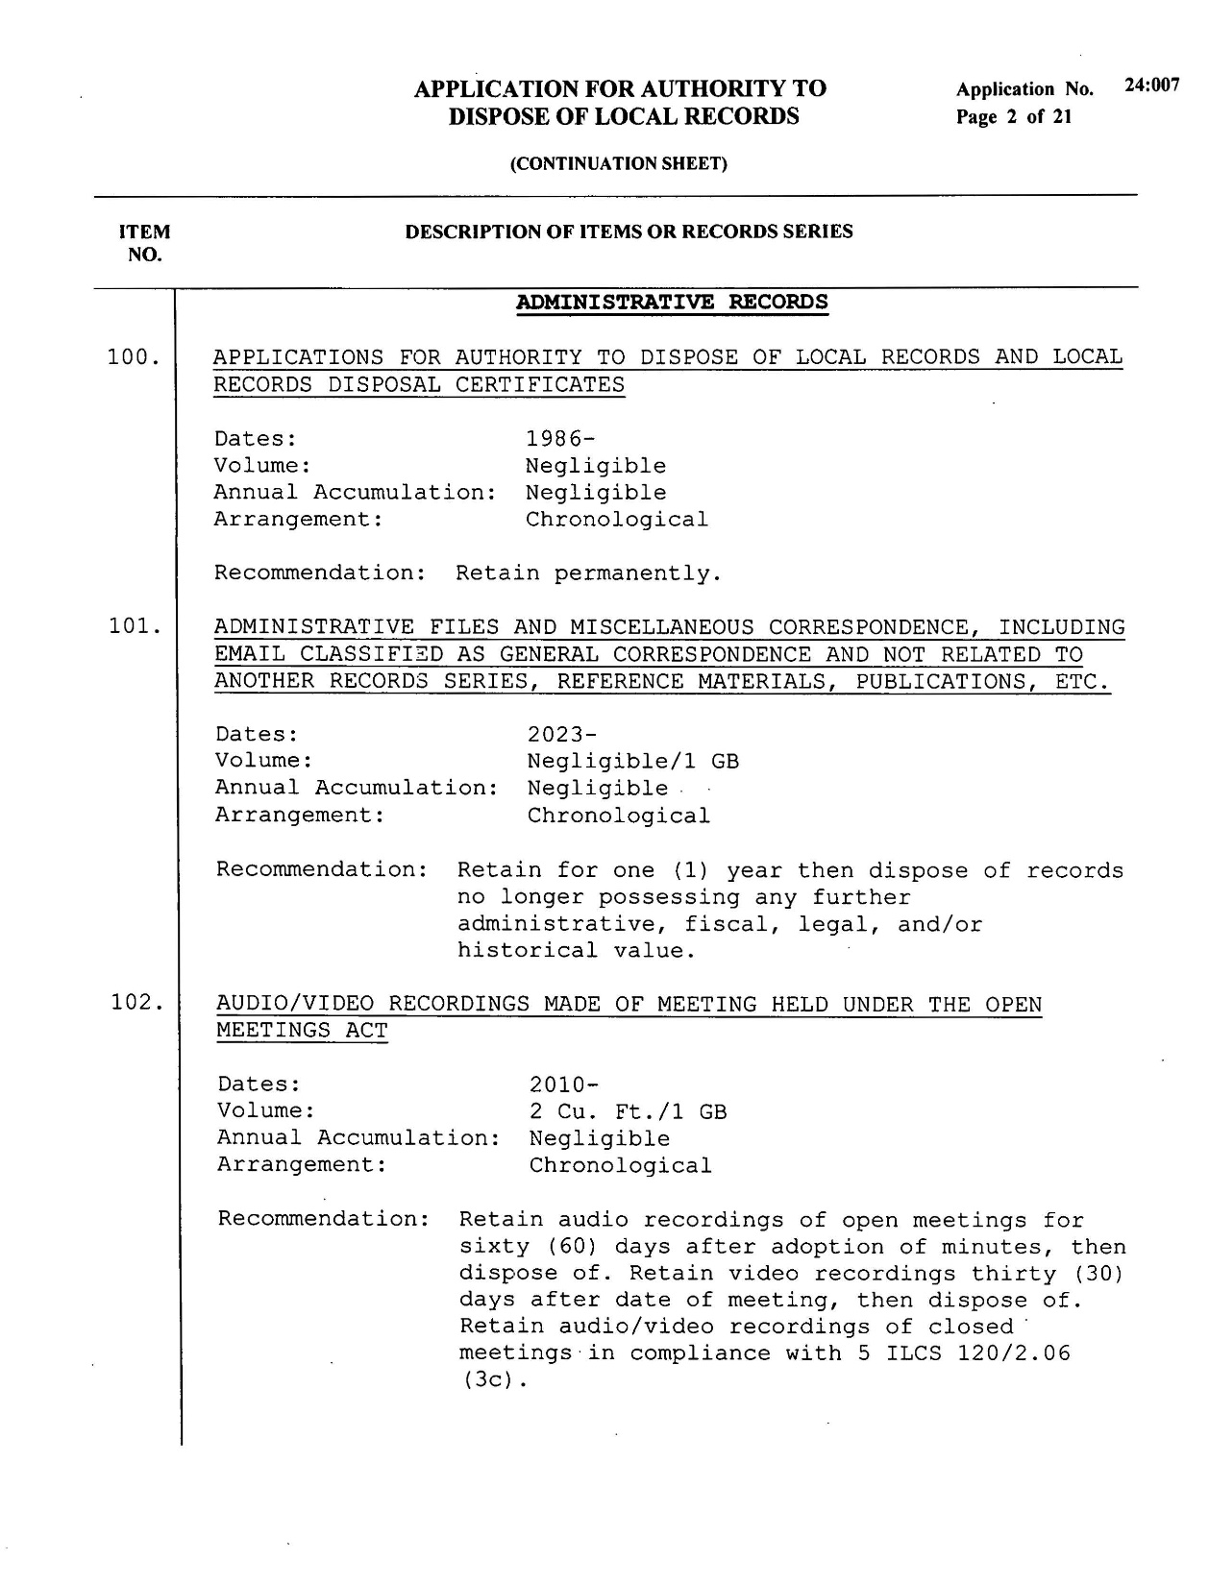
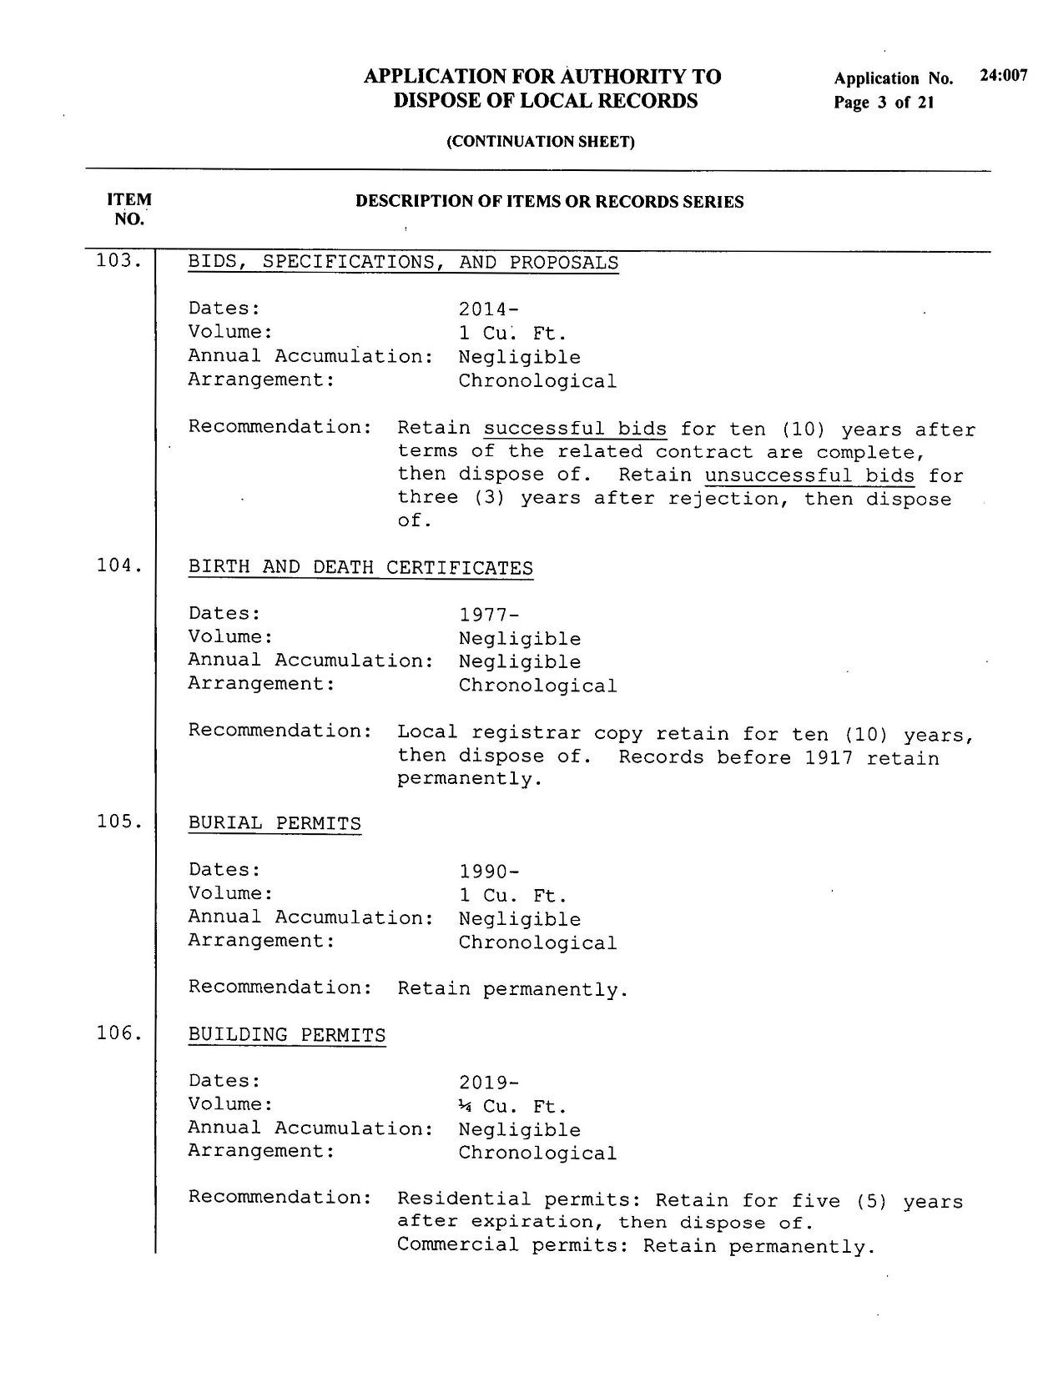
Notes:
Talk about I-9s
Talk about timekeeping records and pay stubs

Slide 15
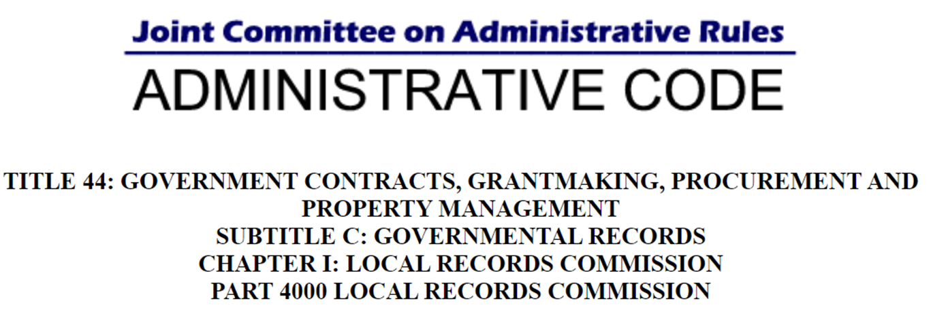
Can records be scanned?

Slide 16

When scanning with intent to dispose of originals:
You MUST file an initial Disposal Certificate for the records that you have scanned and wish to dispose prior to retention met.
Then file a second Disposal Certificate to dispose of the digitized records once they have been retained for the full duration of the original records retention period.
Proceed at your own risk when considering replacing permanent documents with digital surrogates.

Slide 17
Next Stop: Disposal Certificate
Web Search: local records disposal certificate illinois
Download disposal certificate And supplemental page
Save to your computer and use those files so you can reuse them for next year.

Slide 18
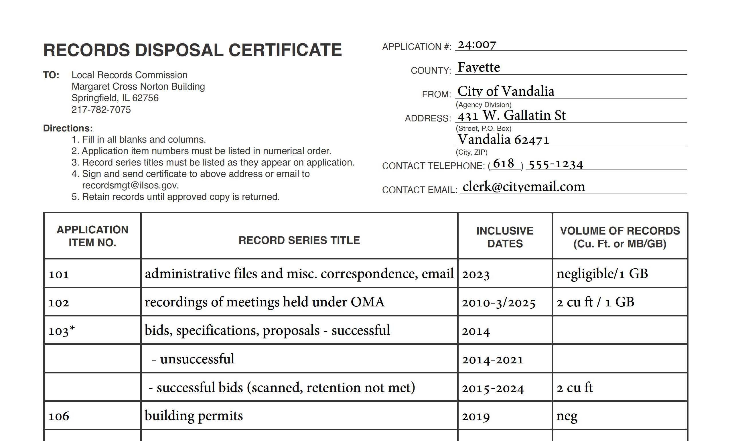




Slide 19
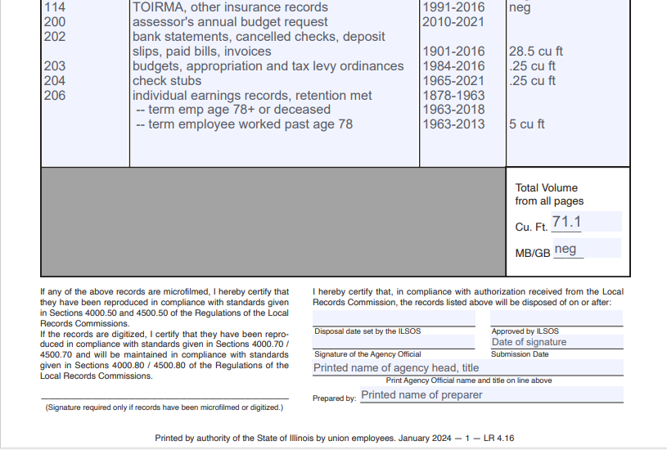
LEAVE BLANK
Your Signature
Sign here if you’ve digitized records

Slide 20
Think proactively.
Submit annually, even if storage space isn’t a concern
Use “Annual Accumulation” as a guide for volume
Submit for all non-permanent record series
Same certificate each year – just change the dates.

Slide 21
Now what?
Print your disposal certificate & hand-sign
Scan and email to recordsmgt@ILSOS.GOV
Certificate is approved or rejected & returned
Plan to dispose of the records on or after the disposal date on the certificate
Print and file the received Disposal Certificate with your APP & keep permanently
Follow JCAR guidelines for proper disposal methods
Notes:
Diamond shredding
Shredding company
May burn if no ordinance and you have the time to stand there until records are completely burned

Slide 22
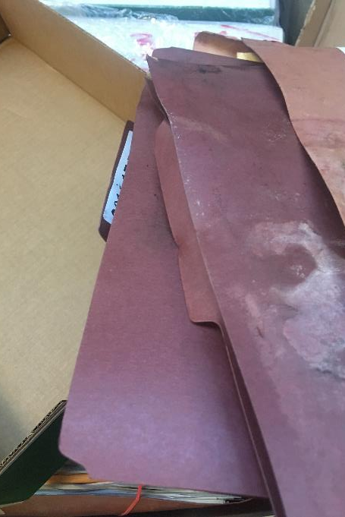
In the event of an emergency…
Fire, weather, insects, building failure, and hacking can damage active records.
DON’T THROW IT OUT WITHOUT APPROVAL!
Call your Field Representative to assist you with an emergency disposal.
Evidence must be provided with a site visit, agency submitted account of damage, and disposal certificate.

Slide 23
Ideas for an efficient approach…
Contact your Field Rep. We’re here to help you.
Assign records management tasks in a JOB DESCRIPTION
Label records boxes or electronic files by both year AND disposal date (email, too!)
Arrange records to match your application for easy management.
The best way to understand it is to just do it!

Slide 24

Remember the benefits:
Avoid legal entanglements which result from violating the Local Records Act. (It’s a class 4 felony!)
If your agency is FOIA’d for information that you have disposed of, you can provide proof that you have legally disposed of the record in question. (No lawsuit!)
Establishing a records management procedure frees up valuable storage space and saves money. (Cleans your closet, your drive, and your mind!)

Slide 25
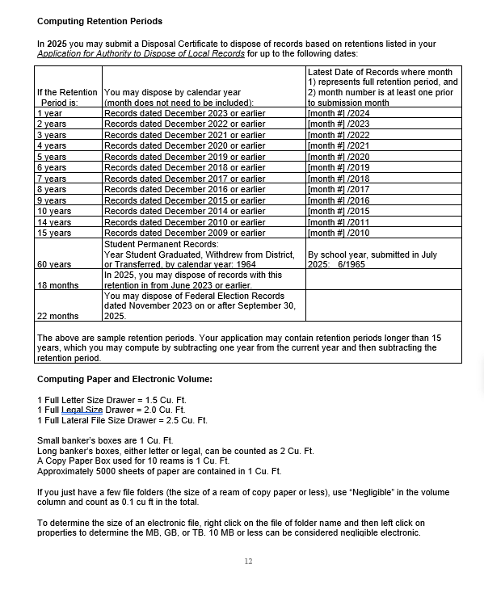
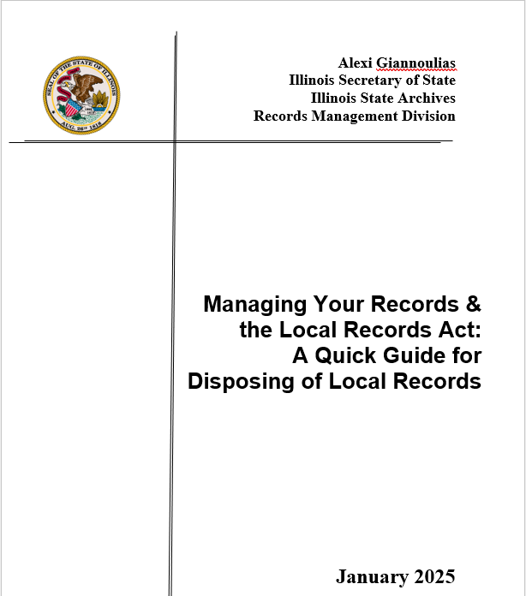
Some helpful tools:

Slide 26
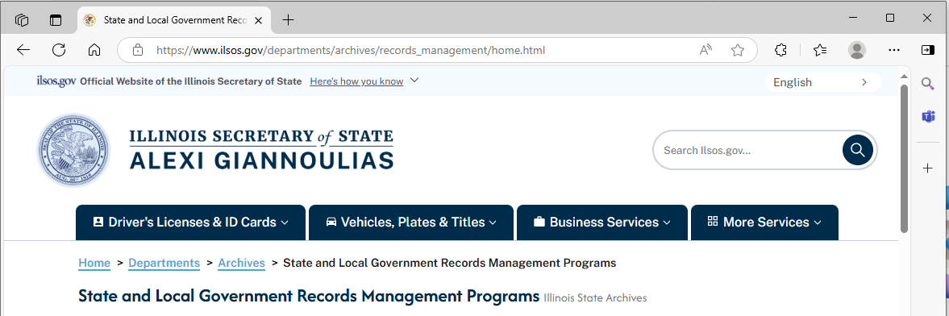
Where to find us:

