Slide 1

Making It Personal – Illinois Personal Property in History and Practice
Timothy A. Jorczak, CAE, AAS, CIAO
McLean County, Illinois

Slide 2



One minute.
Big impact.
Complete the session feedback form.
RATE THIS SESSION

Slide 3
First Things First

Slide 4

Definitions
Real Property
Real Property
Consists of the interests, benefits, and rights inherent in the ownership of land plus anything permanently attached to the land or legally defined as immovable; the bundle of rights with which ownership of real estate is endowed.
Real Estate
The physical parcel of land and all improvements permanently attached. i.e., “the dirt, the sticks, and the bricks.”
Tangible Personal Property
Real Estate
Tangible Personal Property
Includes most movable items, but can include sales tax, freight, installation costs, and all other costs required to place the item into service. Also known as “chattel”.
Intangible Personal Property
Property that has no physical existence beyond merely representational, nor any extrinsic value; i.e., stocks, bonds, goodwill, franchises, etc.
Intangible Personal Property

Slide 5

Real vs. Personal - Hotel
Real Property
Personal Property
Walls
Floor
Electrical
Plumbing
Fireplace
Bed
Couch
Dressers
Tables/Chairs Decor

Slide 6
Personal Property in Illinois – A History

Slide 7
Pre-1970
Prior to the 1970 Constitution, personal property was taxed in Illinois on the same basis as real property.
The 1970 Constitution required the General Assembly to abolish the personal property tax by 1979. To offset revenue loss they created a program to replace the tax with a tax on corporate revenues; however, one key issue remained.
Up to this point, assessors didn’t have any standard guidelines for what was valued as real versus what was valued as personal; thus, it varied jurisdiction by jurisdiction.

Slide 8



Personal Property Prior to 1970
Sangamon County
Water Tower
Assessed as Real Property
Logan County
Water Tower
Assessed as Personal Property

Slide 9
1970 Constitution and the Freeze Act
Up to this point, assessors didn’t have any standard guidelines for what was valued as real versus what was valued as personal; thus, it varied jurisdiction by jurisdiction.
For almost a decade the General Assembly struggled to implement this change, until the passage of the Freeze Act of 1979. This established the parameters of how counties were to proceed.
How a property was treated, real or personal, at the passage of this law was the basis for how it would be valued moving forward.

Slide 10
Freeze Act of 1979
Logan County
Water Tower
Assessed as Personal Property prior to 1979
Logan County
New, Better Water Tower in 2006
Still Treated as
Personal Property (not assessed)
Sangamon County
Water Tower
Assessed as Real Property prior to 1979
Sangamon County
New, Better Water Tower in 2006
Still Treated as Real Property (assessed)

Slide 11
Interpretation and Practice

Slide 12
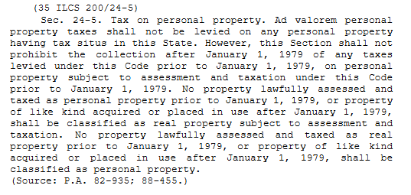
1983: Like-Kind Rule
The first practical matter: how do we treat things moving forward? The Freeze Act was amended in 1983 to allow for similar treatment of “Like-Kind” property.
Later courts would make determinations based on the definition of “Like-Kind”. Courts have established a four-pronged test for establishing a like-kind relationship:
Performance of the same function;
Production of the same product;
Similar portability and manner of attachment;
Replacement of existing equipment.
County of Whiteside v. Property Tax Appeal Board, 276 Ill.App.3d 182 (1995)

Slide 13

Like-Kind Rule
Sangamon County
Water Tower
Assessed as Real Property
Sangamon County
Corn Syrup Storage Tank
Assessed as Real Property

Slide 14
Beeler – The “Intention Test”
The next question: How do we treat “new” (i.e., previously unclassified) types of property?
In the McLean County case In re Application of Beeler, 106 Ill App. 3s 667, 435 N.E. 2d 1357 (1982), the Appellate court created a three-pronged “intention test” for classifying property. If an item in question met ALL 3 criteria, it was to be considered real property and thus taxable.
1. The property must be “annexed to the realty or something appurtenant thereto” – Meaning it must be attached either to the land, or something attached to the land.
2. The property must be “applied to the use or purpose to which that part of the realty, with which it is connected, is appropriated”.
3. The party who is making the annexation must “intend to make a permanent accession to the freehold.”
1.

Slide 15

Beeler Example
New Amusement Park
An amusement park is being constructed in your county. Having never had such a property before, you need to make a decision on the rides. How does Beeler apply?
Annexed to the realty?
Applied to the use of the realty to which it is connected?
Intended to be permanent?

Slide 16
Integrated Industrial Plant Doctrine
This is a tax accounting term traditionally used to ascertain a component’s sales and use tax liability; however, Illinois has given it application to the real vs. personal discussion.
In its original meaning, the more integral a piece of equipment is to its accompanying going concern, the more likely it is to be exempt from sales and use tax. In Beeler, the court carried this idea forward into the realty realm.
“[T]he higher degree of a relationship between the contested property and the uses of the realty, the more assuredly it can be said that the property is a part of the realty.” Beeler at 672
One final note: Beeler is a companion to the Like-kind rule, not a precedent overruling it; Like-kind will always be the first consideration. Beeler only applies in cases where a like-kind use is absent.

Slide 17
Separating Personal Property from Realty: the Three Approaches

Slide 18



Sales Comparison Approach
Provided sufficient data and proper comparability, personal property can be estimated from market data.
This can be as simple as identifying machinery from other sources.
Example: A restaurant building sells for $500,000 with almost-new refrigerator, freezer, and convection oven. Similarly-aged used machinery sells as follows:
$500,000 - $48,850 = $501,150 (approx. 10%)

Slide 19
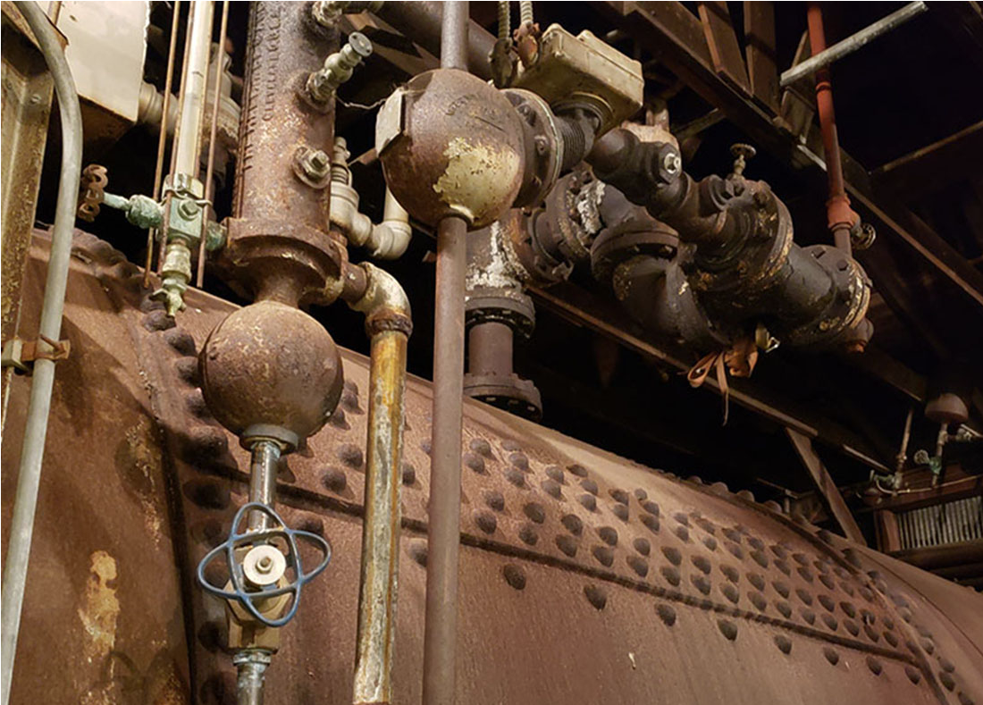
Cost Approach
The Cost approach allows for the most categorical and thorough method for valuation.
The depreciable personal property is inventoried, the replacement cost is developed, and it is depreciated according to its useful economic life. (This is how most states value personal property for tax purposes.)
Example: An industrial agricultural building fitted with a three-year old removable peppermint oil distillation apparatus sells for $350,000. Such devices have a ten-year life and retail new for $50,000.
Depreciated value $50,000 – 30% (3/10) = $35,000
Real Estate Value: $350,000 - $35,000 = $315,000

Slide 20
Income Approach
Income capitalization is the most complex, but also the most quantifiable and likely accurate method.
One method is to identify the replacement reserves (and any other expenses) for the property then capitalize the result and subtract it from the overall value.
Example: You are valuing a franchised hotel property for appeal purposes that generates $1,875,000 in gross revenue. You analyze their income and expense statements and identify they just had a personal property branding “refresh” with a seven-year expected life cycle that cost $1,000,000. They also pay a 5% franchise fee on their gross room income. The property’s net operating income is $750,000 and your local cap rate is 10%. The expected return for the business is 15%.

Slide 21

Income Approach
Calculation
Total real property value: $750,000 / .10 = $7,500,000
Less tangible personal property: $142,857 RR ($1,000,000 / 7) / .15 = $952,380
Less intangible personal property: $93,750 / .15 = $625,000
Total Real estate value: $7,500,000 - $952,380 - $625,000 = $5,922,620

Slide 22
Contact:
Timothy A. Jorczak, CAE, AAS, CIAO
McLean County Supervisor of Assessments 115 E. Washington St. Rm. 101
Bloomington, IL 61702
309-888-5130 timothy.jorczak@mcleancountyil.gov

