Slide 1

Making Your Website Accessible: Your Responsibilities under the Americans with Disabilities Act (ADA)
Presented By: Shaun Harner, CIAO

Slide 2

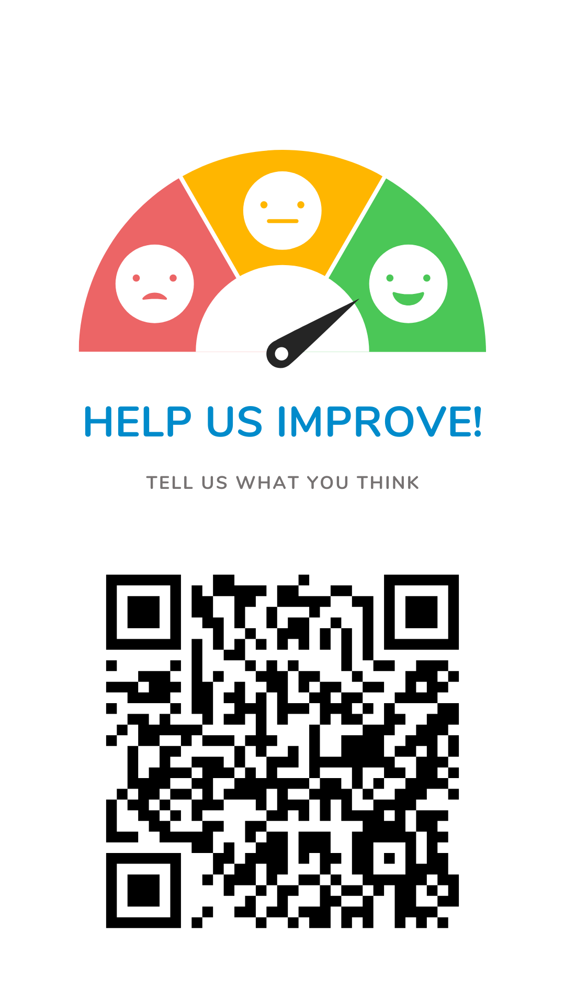

Complete the session feedback form.
One minute.
Big impact.
Complete the session feedback form.
RATE THIS SESSION

Slide 3
Web Accessibility?

Slide 4

What is Web Accessibility?
Websites, applications, tools, and technologies should be designed and developed so that people with disabilities can use them.
Allows individuals to perceive, understand, navigate, interact, and contribute to the web.
We want to ensure that online information and communication is readily available to all people regardless of barriers or disabilities.

Slide 5

Why is Web Accessibility Important?
Many individuals rely on assistive technology to access the web.
Screen Readers are an example.
When online content isn’t accessible, it creates barriers for individuals with disabilities.
Public service is about meeting the needs of the public, which includes individuals with disabilities.

Slide 6
Why is this important for you? (1 of 2)
State and Local Governments must comply with Web Content Accessibility Guidelines (WCAG) 2.1 Level AA for web content and mobile apps by their compliance deadlines.
Governments with a population less than 50,000 and Special District Governments have until April 24, 2027.
Governments with a population of 50,000 or more have until April 24, 2026.
Web Content includes third-party content as well.
Do you have an online property inquiry from a contracted vendor?

Slide 7
Why is this important for you? (2 of 2)
A study by the CDC found that one in four US adults are living with some form of disability.
www.cdc.gov/disability-and-health/articles-documents/disability-impacts-all-of-us-infographic.html
Over 5,000 federal lawsuits for website accessibility were filed in 2025.
accessiblemindstech.com/ada-web-lawsuits-2026-insights-from-2025-filings/
More than 21.3% of the US population rely on assistive technology to access the web.
www.naspo.org/news/accessibility-by-design-preparing-for-website-ada-compliance-deadlines-with-the-right-tools/
Only 4% of the internet and 5.2% of websites are fully accessible to people with disabilities.
www.accessibility.works/blog/only-5-percent-websites-pass-wcag-ada-eaa-compliance/

Slide 8
WCAG 2.1 AA

Slide 9
What is WCAG 2.1 AA?
A 2024 final rule was issued by the Department of Justice updating regulations for Title II of the Americans with Disabilities Act (ADA).
This rule set Web Content Accessibility Guidelines (WCAG) 2.1 Level AA.
Wide range of recommendations for making web content more accessible.
While the content covers accessibility for a wide range of issues, they are unable to address every issue.
Web content on any kind of device (desktops, laptops, kiosks, and mobile devices) is included

Slide 10




4 Principles of WCAG 2.1 AA
Perceivable
Operable
Understandable
Robust
Information and user interface components must be presentable to users in ways they can perceive
User interface components and navigation must be operable
Information and the operation of the user interface must be clear and understandable
Content must be robust enough to be interpreted by a wide variety of user agents, including assistive technologies
There are 13 Guidelines under each of these that provide basic goals for anyone creating content that provide framework.

Slide 11

Guidelines
Each guideline has a testable Success Criteria where requirements and testing are necessary.
Each Guideline and Success Criteria has a wide variety of Techniques, either Sufficient or Advisory.
Sufficient means meeting the Success Criteria.
Advisory means it goes beyond meeting the Success Criteria to better address the Guidelines.

Slide 12
Exceptions to WCAG 2.1 AA

Slide 13
Archived Web Content
The content was created before the compliance date or reproduces paper documents or the contents of other physical media that were created before the compliance date, and
The content is kept only for reference, research or recordkeeping, and
The content is kept in a special area for archived content, and
The content has not been changed since it was archived.
The archived content must meet all the criteria listed!

Slide 14
Pre-existing Conventional Electronic Documents and Certain Third-Party Content
Pre-existing Conventional Electronic Documents
The documents are word processing, presentation, PDF, or spreadsheet files, AND
They were available on the website or mobile application before the compliance date.
Certain Third-Party Content
Content posted by a third party where the third party is not posting due to contractual, licensing, or other arrangements with a public entity.
Example: a message that a member of the public leaves on an online message board.

Slide 15
Individualized Documents that are Password Protected and Pre-existing Social Media Posts
Individualized Documents that are Password Protected
The documents are word processing, presentation, PDF, or spreadsheet files, and
The documents are about a specific person, property, or account, and
The documents are password protected or otherwise secured
Pre-existing Social Media Posts

Slide 16
How is McLean County addressing Web Content Accessibility?

Slide 17
McLean County’s Approach
Information Technologies (IT) Department immediately looked into the Guidelines and began holding Training Sessions within 4 months of the Department of Justice Ruling.
Major shout out to Dan Leary in our IT Department for informing, training, teaching, and answering all of our repeat questions!
IT reached out to our Website Content Management (CMS) provide, CivicPlus, for resources and compliance questions.
IT set up a workflow to evaluate our website and its content and looked into widgets, software, and other options to help with compliance.
Software and widgets can help increase accessibility, but it will never be a completely hands-off approach.
Just using widgets does not fulfill obligations to have an accessible website or content!

Slide 18
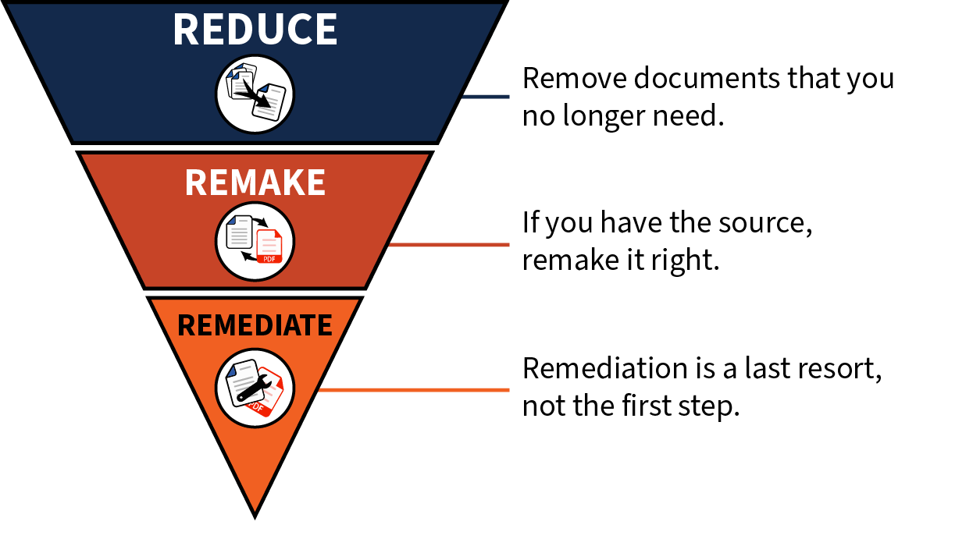
Accessible Content Workflow
Educate
Reduce
Remove documents that you no longer need.
Remake
If you have the source, remake it right.
Remediate
Remediation is a last resort, not the first step.

Slide 19
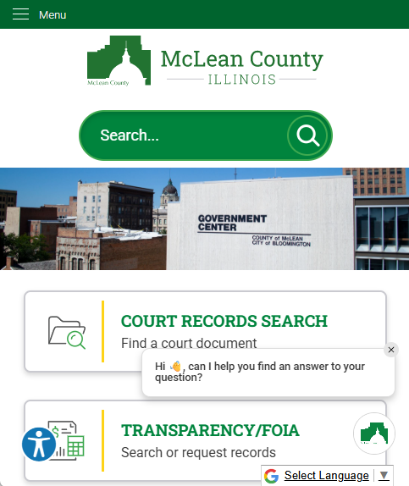
Software Used by McLean County
Acquia Web Governance (DubBot similar)
Accessibility scanning and reporting tool that identifies errors, warnings, and potential issues.
Still need manual review.
Audio Eye
Accessibility help desk that is added to the website and get a toolkit to change parts of the webpage to meet accessibility needs.
CommonLook by Allyant
Remediation tool for pdfs and office products
DocAccess (looking into getting)
Uses Optical Character Recognition technology to convert items in pdfs into a compliant text version

Slide 20
How to Move Forward?

Slide 21
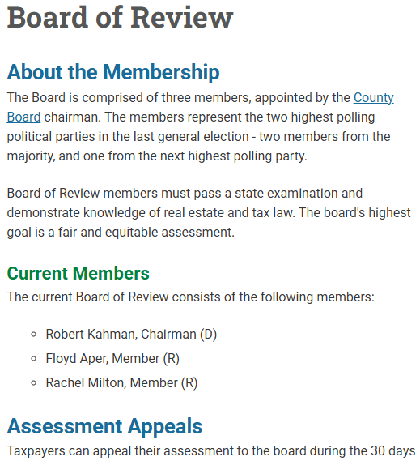
Things to Look For (1 of 3)
Use headings appropriately to organize information.
Images and Non-Text Content should have alternative text that conveys the same information.
Decorative images should be marked as decorative.
Hyperlinks should describe where the link is taking you.
Don’t write “click here”
Example: Before you submit a complaint, please review the Guidelines for Assessment Complaints (PDF).

Slide 22

Things to Look For (2 of 3)
Color and Contract
Color by itself can’t be the only means of communicating information.
Always double check your text to background contract.
Example: Hard to Read? or Hard to Read?
Tables should be used to show relationships between data or information, not for structure or layout.
Don’t leave cells blank.

Slide 23

Things to Look For (3 of 3)
Readability
Use simple language.
Avoid technical jargon.
Explain acronyms.
Use consistent terminology and content structure across pages.
Avoid walls of text.

Slide 24
Documents and Multimedia
Documents
Accessibility tags are required for ADA compliance.
Include metadata.
Avoid scanned documents.
Scanned documents show up as images, and you would need to use OCR to convert it back to text
Multimedia
Include text transcripts for audio and video files.
Adobe Premiere or Microsoft Stream have options to create transcripts.
Videos must include captions.
Audio description of visual information.

Slide 25

Social Media
Don’t use color alone to convey information!
Include alternative text on all images.
Images of text must include the text in the body of the post.
Include description of the link destination before a hyperlink.
If linking to anything other than a webpage, indicate the content type.
Don’t overuse emojis or replace with emojis
Videos must include captions.

Slide 26
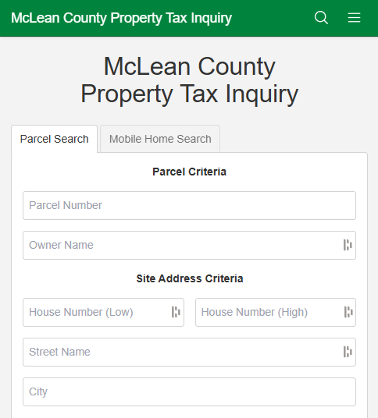
Third Party Content
Third party content created for or posted on behalf of your organization must be compliant.
Communicate the importance of accessibility and find out how they are working to comply with WCAG 2.1 AA.
Ask for an Accessibility Conformance Report (ACR) or a completed Voluntary Product Accessibility Template (VPAT).
If not available, direct them to the VPAT website and request they complete a VPAT for WCAG.

Slide 27
Creating Accessible Content

Slide 28
Creating Accessible Content (1 of 3)
Headings must be clear, concise and give the reader an idea of the content found below.
Avoid copying and pasting content from other sources into the text editor.
Keep sentences simple and avoid using technical jargon and acronyms.
Acronyms should be spelled out the first time it’s used on a page with the acronym in parenthesis at the end.
Do not type in all caps. It reduces readability.
Do not underline text. Underlining should be reserved for links.
Avoid using bold and italicized for emphasis. Screen readers don’t catch these all the time.

Slide 29
Creating Accessible Content (2 of 3)
Links should make sense out of context.
Did you know screen readers separate page links for the page content?
Don’t use “click here.”
Instead, you could use “click here to access the online property database.”
Images are required to have alternative text that describes the image.
Decorative images should be marked as decorative.
Documents and webpages follow the same guidelines.
Have you noticed items that have shown up on previous slides?
Some applications have an accessibility tool built in that will give recommendations (word, excel, etc.).
There will be a review tab, and you can select “Check Accessibility.”

Slide 30
Creating Accessible Content (3 of 3)
Make sure the Metadata is accurate.
Metadata stores information about documents (title, author, etc.).
Usually, you can edit metadata by going to File>Info>Properties>Advanced Properties.
Watch how you save your document as a PDF.
Printing to PDF doesn’t always make an accessible document into an accessible PDF.
There will usually be a save or export as PDF option in the file menu that will create a PDF and have guided actions to help ensure the PDF will be accessible.

Slide 31
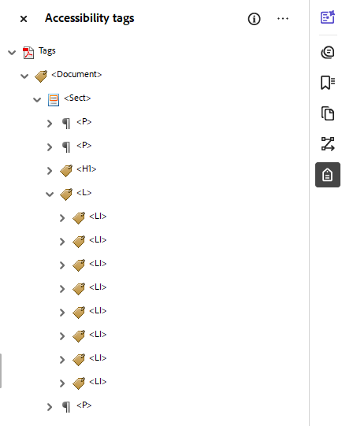
Accessibility Tag Tree
Just because you have created an accessible document doesn’t mean the PDF will be fully accessible!
Always review your tag tree on your pdf!
The tag tree will show you the document structure, what tags are associated with your content, and how the document is meant to be read.
Things to watch out for are Header Levels in a logical format, H1 before H2 for example.
Check that Lists have List Items.

Slide 32
Take Aways and Helpful Links

Slide 33

Take Aways
There is no such thing as an error-free website.
Make a good faith effort to improve accessibility.
Build a Culture of Accessibility.
Widgets alone won’t make your website accessible.
Making accessible content will take time.
Educate and work with others in your organization to meet your jurisdiction size’s deadline.

Slide 34
Helpful Links (1 of 3)
Fact Sheet: New Rule on the Accessibility of Web Content and Mobile Apps Provided by State and Local Governments
www.ada.gov/resources/2024-03-08-web-rule/
Web Content Accessibility Guidelines (WCAG) 2.1
www.w3.org/TR/WCAG21/
DOJ Full Final Rule
www.ada.gov/assets/pdfs/web-rule.pdf
How to Meet WCAG (Quick Reference)
www.w3.org/WAI/WCAG22/quickref/?versions=2.1&currentsidebar=%23col_customize&showtechniques=111

Slide 35
Helpful Links (2 of 3)
Planning and Managing Website Accessibility
www.w3.org/WAI/planning-and-managing/
Easy Checks
www.w3.org/WAI/test-evaluate/preliminary/
Developing an Accessibility Statement
www.w3.org/WAI/planning/statements/
Disability Impacts All of Us Infographic
This is a great example of how to present non-text information in an alternate format.
www.cdc.gov/disability-and-health/articles-documents/disability-impacts-all-of-us-infographic.html?CDC_AA

Slide 36
Helpful Links (3 of 3)
8 Tips, Tricks, and Best Practices for Digital Accessibility
www.civicplus.com/blog/wa/8-tips-tricks-best-practices-digital-accessibility/
Accessibility of Web Content and Mobile Apps Provided by State and Local Government Entities: A Small Entity Compliance Guide
www.ada.gov/resources/small-entity-compliance-guide/
Web Accessibility Checklist for Local Government Websites from CivicPlus
info.civicplus.com/hubfs/0_Web-Accessibility/18-Checklist-Web-Accessibility-for-Local-Government-1010-071525.pdf
Contrast Checker
webaim.org/resources/contrastchecker/

